Slide 1


Robotics Corner

Slide 2
Computer Vision

Slide 3



Agenda
01
Basics of Image processing
image processing filters
types of processing
traditional Computer vision based machine learning
Computer vision based deep learning
01285960031
01285960031
www.roboticscorner.tech

Slide 4
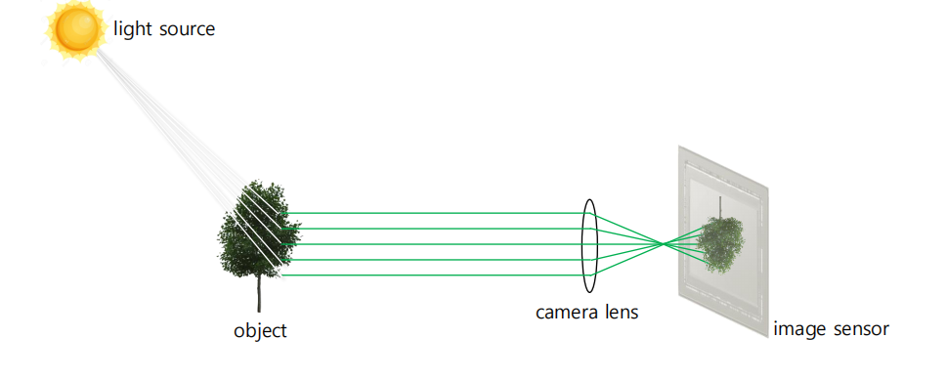
How Camera works
01285960031
01285960031
www.roboticscorner.tech

Slide 5
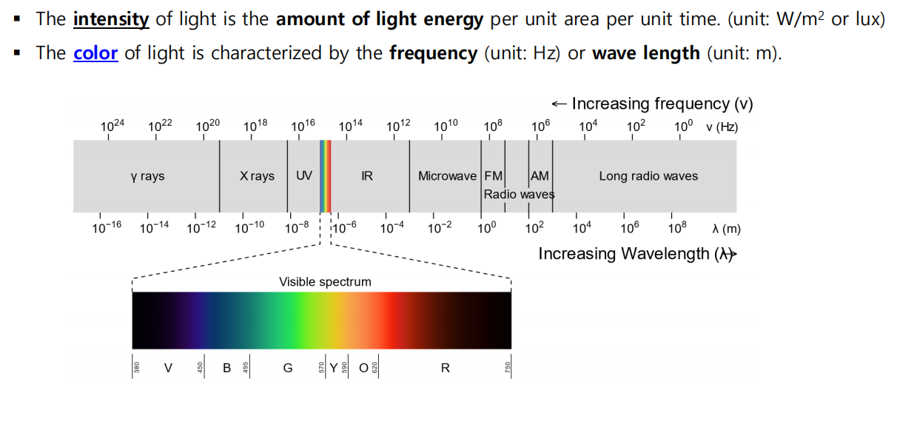
01
Computer Vision
Color Spaces
01285960031
01285960031
www.roboticscorner.tech

Slide 6
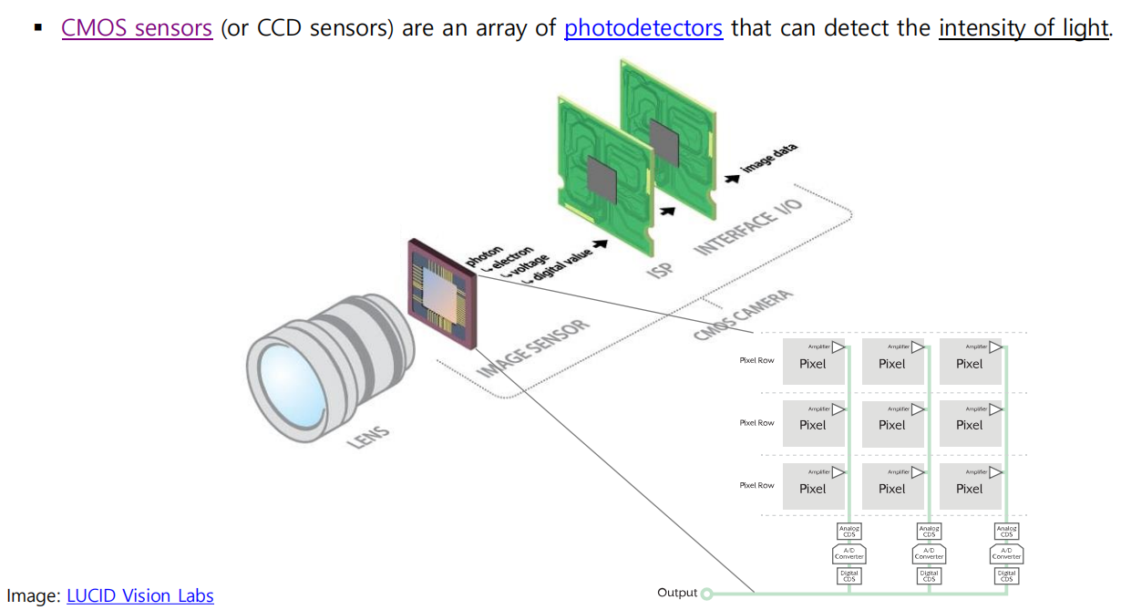
01
Computer Vision
01285960031
01285960031
www.roboticscorner.tech

Slide 7
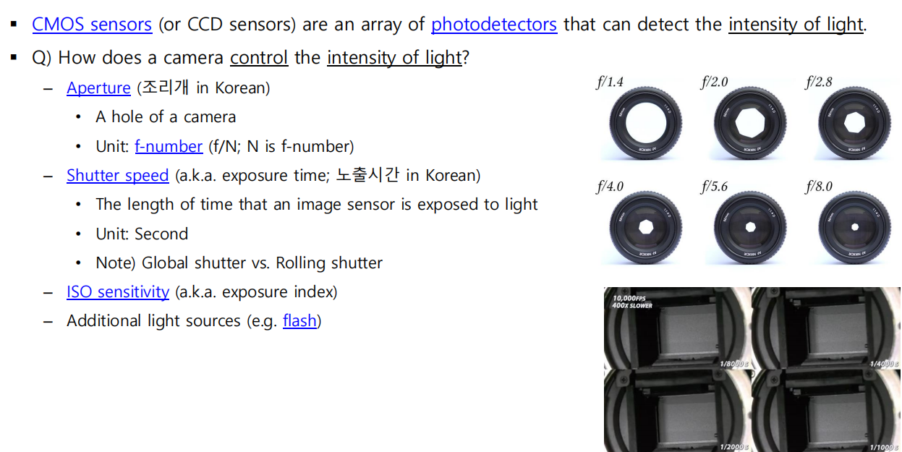
01
Computer Vision
01285960031
01285960031
www.roboticscorner.tech

Slide 8
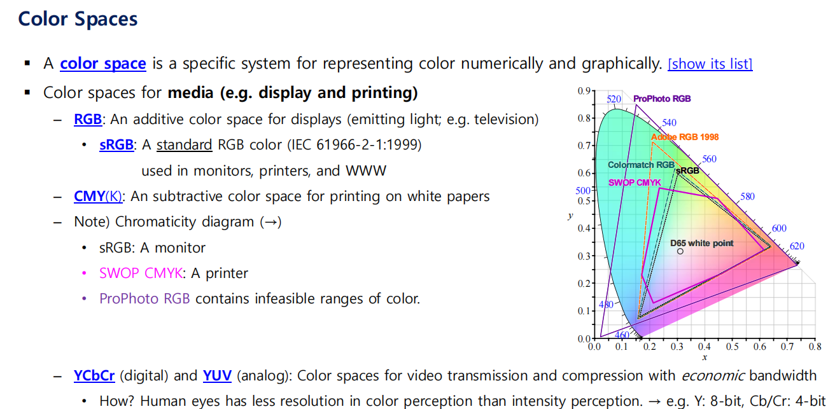
01
Computer Vision
01285960031
01285960031
www.roboticscorner.tech

Slide 9
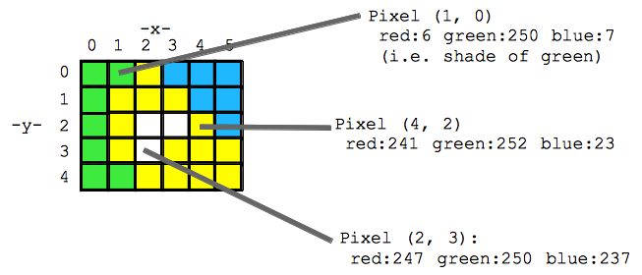
01
Computer Vision
What is an image
it’s two dimentional representation for visual information and it contains pixels each one of them has values depending on the color space i.e RGB 3 channels .
Grey scale is just one channel.
What is an Video
is a sequence of images
01285960031
01285960031
www.roboticscorner.tech

Slide 10
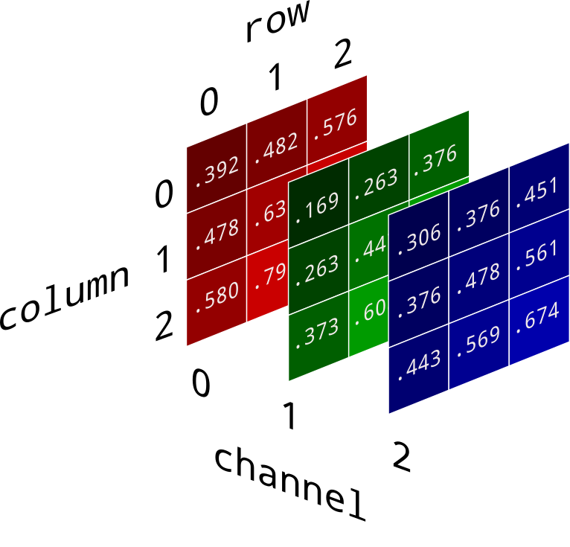
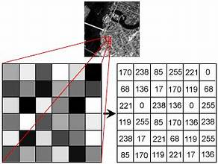
01
Computer Vision
Image in RGB
Image in Grey scale
01285960031
01285960031
www.roboticscorner.tech

Slide 11
01
Computer Vision
Camera types
Monocular Cameras: Standard single-lens cameras that capture 2D images.
Applications:
Object detection and recognition.
Visual navigation using Simultaneous Localization and Mapping (SLAM).
Texture and pattern analysis.
Stereo Cameras: Two cameras placed at a fixed distance apart, mimicking human binocular vision to capture depth.
Applications:
Depth estimation and 3D reconstruction.
Autonomous navigation and obstacle avoidance.
Robotics manipulation (grasping and object positioning).
01285960031
01285960031
www.roboticscorner.tech

Slide 12
01
Computer Vision
Omnidirectional Cameras: Provides a 360-degree field of view using fisheye lenses or mirror assemblies.
Applications:
SLAM in complex environments.
Surveillance and monitoring.
Autonomous vehicle navigation.
Lidar Cameras: Uses laser pulses to generate 3D point clouds of the environment.
Applications:
Autonomous driving (mapping and obstacle detection).
Drones for terrain mapping.
Robotics for precise localization.
Event-Based Cameras: Capture changes in a scene by detecting pixel-level intensity differences instead of full-frame images.
Applications:
High-speed motion detection.
Robotics in dynamic environments.
Neuromorphic computing and vision.
01285960031
01285960031
www.roboticscorner.tech

Slide 13
01
Computer Vision
Camera Type | Strengths | Limitations
Monocular | Affordable, simple | No depth information
Stereo | Depth perception | Calibration challenges
RGB-D | Color + depth | Limited range and lighting issues
Time-of-Flight (ToF) | High-accuracy depth sensing | Sensitive to ambient light
Thermal | Works in darkness, detects heat | No color or texture information
Event-Based | High-speed motion detection | Specialized processing needed
Omnidirectional | 360° view | Distortion and high computation
Lidar | Accurate 3D mapping | Expensive and weather-sensitive
High-Speed | Captures rapid movements | Expensive and data-intensive
Hyperspectral/Multispectral | Material analysis | Complex and costly
01285960031
01285960031
www.roboticscorner.tech

Slide 14
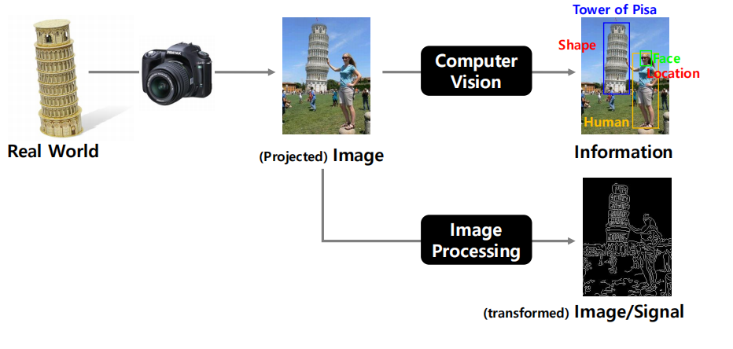
01
Computer Vision
What tasks can be done by CV
Pattern Recognition
Prediction
Segmentation
Generation
01285960031
01285960031
www.roboticscorner.tech

Slide 15
02
Computer Vision
Image processing:
Intensity Transformation
– Contrast Stretching
– Histogram Equalization
▪ Image Segmentation
– Thresholding
▪ Image Filtering
– Smoothing
– Edge Detection
– Sharpening
▪ Morphological Operations
– Erosion and Dilation
– Opening and Closing
01285960031
01285960031
www.roboticscorner.tech

Slide 16
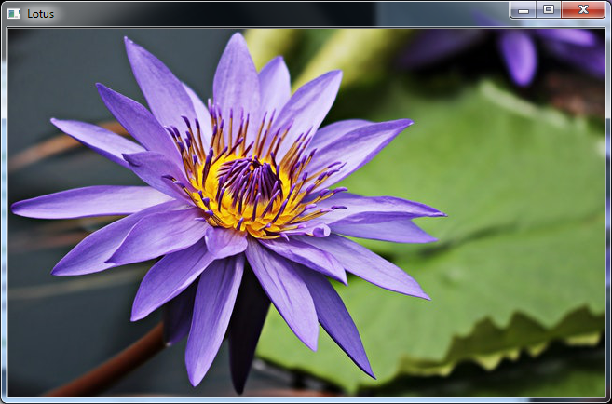
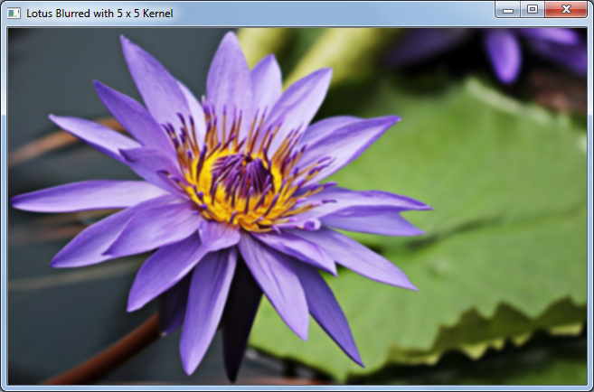
02
Computer Vision
Image processing Filters:
Gaussian blurring: follow code https://www.opencv-srf.com/2018/03/gaussian-blur.html
01285960031
01285960031
www.roboticscorner.tech

Slide 17
Types of processing
03
OpenCV Overview
Processing in time domain
definition:
All processing in time domain is done via Convolution
A signal in the time domain is represented as a function of time, such as
x(t) for continuous signals or x[n] for discrete signals.
Convolution:
A mathematical operation in the time domain to combine two signals (e.g., input signal and system response).
01285960031
01285960031
www.roboticscorner.tech

Slide 18
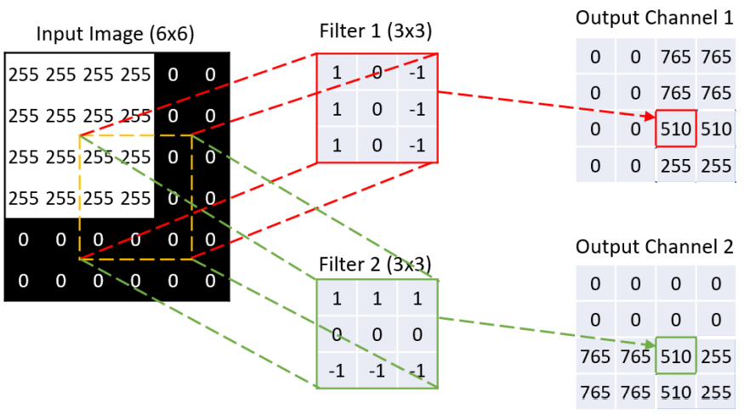
Convolution Example
03
OpenCV Overview
الضرب الالتفافى
because it’s done in time domain and images are pixels (each pixel is in certain place) so it’s also known as spatial domain filtering
e.g: Gaussian filter and Median Filter used for functions like blur
01285960031
01285960031
www.roboticscorner.tech

Slide 19
Processing in frequency domain
03
OpenCV Overview
also known as temporal filtering because the time domain processing is based on convolution and it’s a heavy computation, frequency domain processing has taken a good place because it’s less expensive computation than convolution since combining two signals here it turns to be a simple multiplication.
01285960031
01285960031
www.roboticscorner.tech

Slide 20
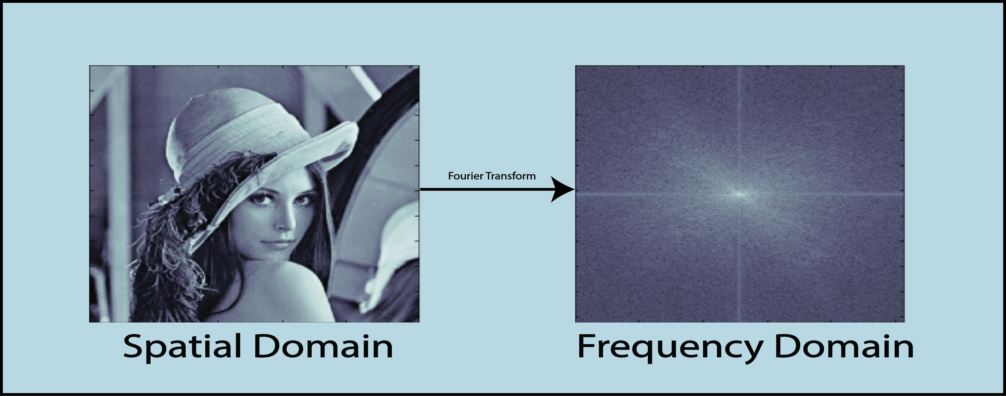
Processing in frequency domain
03
OpenCV Overview
01285960031
01285960031
www.roboticscorner.tech

Slide 21
Processing in frequency domain
03
OpenCV Overview
Fourier transform
Filter function
Inverse Furier Transform
Low pass filter
High pass Filter
Band pass filter
Band reject filter
Input image
Output image
01285960031
01285960031
www.roboticscorner.tech

Slide 22
Apps can be done using Traditional CV
04
OpenCV Overview
Object tracking using Color Decection
Face detection using Cascade Classifier
Pedestrian detection using HOG (Histogram Oriented Gradient)
note: the above are hyperlinks to code and tutorials
01285960031
01285960031
www.roboticscorner.tech

Slide 23
Difference between Machine and deep learning
04
OpenCV Overview
Machine learning when there is a small amount of data and features are given to the algorithm e.g: Support vector machines (SVM), KNN and Bayes classifier
frameworks and libraries: opencv and skitlearn
Deep learning is when there is a huge amount of data and features to be extracted by the algorithm. e.g: Convolutional neural network(CNN) best for pattern recognition, Recurrent neural network (RNN) and transformers
Frameworks: Tensorflow and tensorflow lite and pytorch
01285960031
01285960031
www.roboticscorner.tech

Slide 24
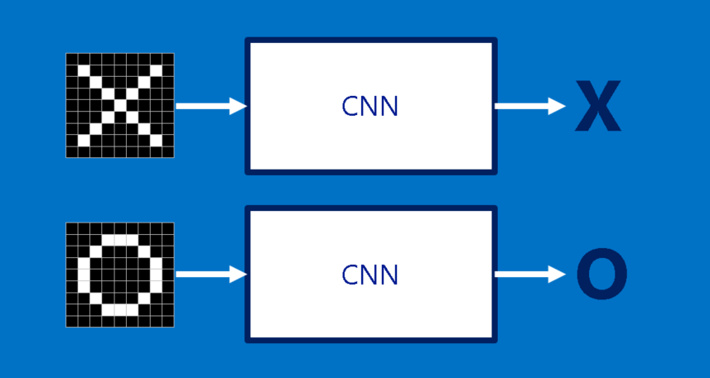
CNN : Convolutional neural network
05
OpenCV Overview
it’s a deep learning architechture which gives the best results in classification and pattern recognition.
01285960031
01285960031
www.roboticscorner.tech

Slide 25


CNN Architecture
05
OpenCV Overview
cat dog ……
Convolution
The whole CNN
Max Pooling
Can repeat many times
Fully Connected Feedforward network
Convolution
Max Pooling
Flattened
01285960031
01285960031
www.roboticscorner.tech

Slide 26
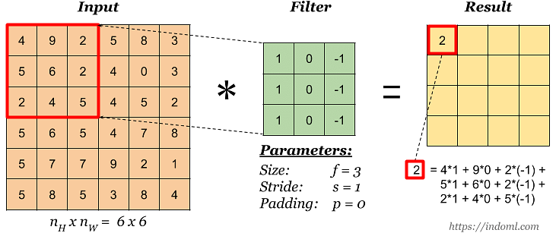
05
OpenCV Overview
01285960031
01285960031
www.roboticscorner.tech

Slide 27


05
OpenCV Overview
Subsampling pixels will not change the object
bird
bird
Why pooling?
Subsampling
We can subsample the pixels to make image smaller
fewer parameters to characterize the image
01285960031
01285960031
www.roboticscorner.tech

Slide 28
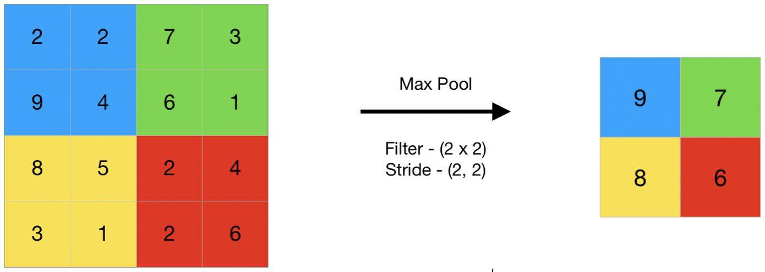
How pooling works
05
OpenCV Overview
01285960031
01285960031
www.roboticscorner.tech

Slide 29
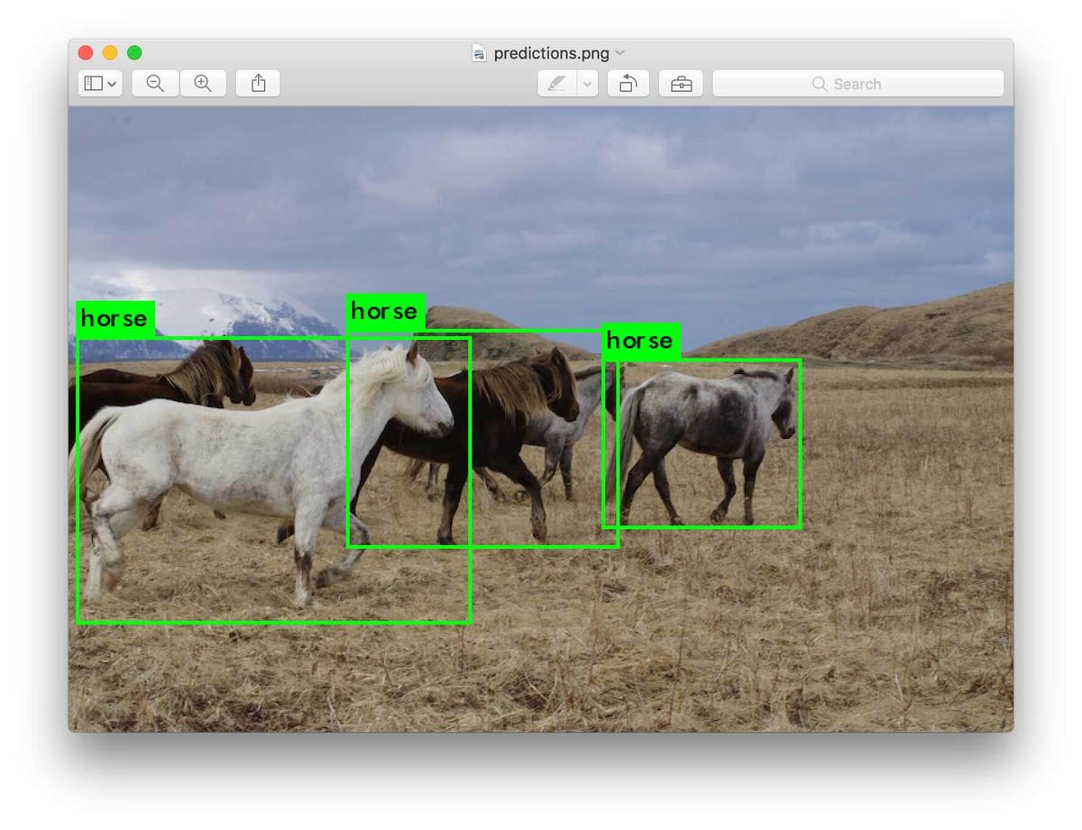
Object classification
05
OpenCV Overview
Object classification is One of good examples of Computer vision using deep learning, YOLO (You Look Only Once) is the state of the art in this area
01285960031
01285960031
www.roboticscorner.tech

Slide 30
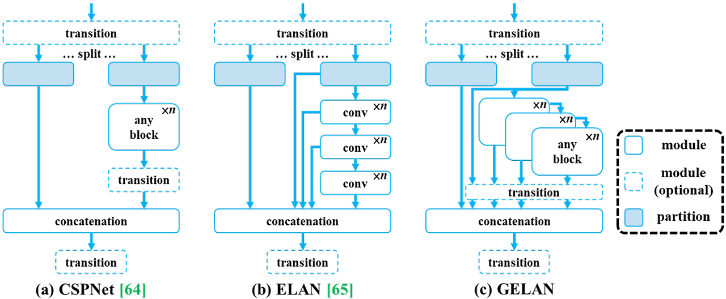
YOLOv9
05
OpenCV Overview
01285960031
01285960031
www.roboticscorner.tech

Slide 31
Practical
05
OpenCV Overview
Follow this guide: https://www.opencv-srf.com/p/introduction.html
YOLOv9 full tutorial : ttps://github.com/WongKinYiu/yolov9?tab=readme-ov-file
01285960031
01285960031
www.roboticscorner.tech

Slide 32



Slide 33

01211626904
www.roboticscorner.tech
Robotics Corner
Robotics Corner
Robotics Corner
Robotics Corner

